Slide 1
New UHF TRx
Weekly meeting 1/11/2023

Slide 2
Commercial transceiver comparison​
From BIRDS-5 Test Measurements ​
​
Tx Power = 12.95 dBm + 15(Atten.(dB)) =28 dBm​
​
CW Power = (4.49 dBm+15(Atten.(dB))) = 19.49dBm​
@ 500Hz channel power width
Expected from new UHF​
​
Tx Power = 2800 mW-700 mW ​
(29dBm -28.45 dBm)​
​
CW Power = 100 mW (20dBm)​
​

Slide 3
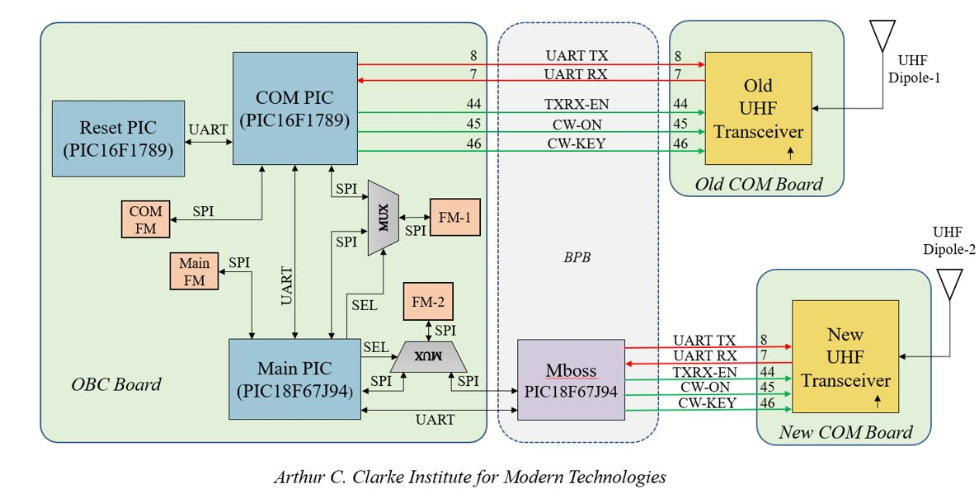
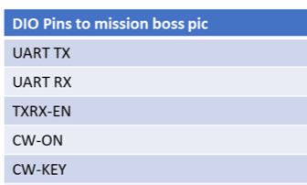
Connections
To Outside
Prog Tx
Prog Rx
Prog reset
UNREG-1 power line will be used

Slide 4
Procurement
We will proceed with P-BAN because the design is not confirmed

Slide 5
Lecture on new UHF
Sunday after 9:30 PM ?

